Slide 1
Software Analysis and Design (CS3004)
Course Instructor: Nida Munawar
Email Address: nida.munawar@nu.edu.pk
Lecture 2 & 3

Slide 2
Software Development Lifecycle
What is lifecycle?
What is software development?

Slide 3
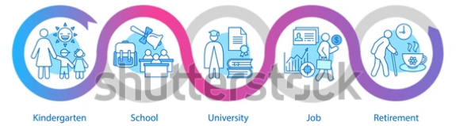
Lifecycle

Slide 4
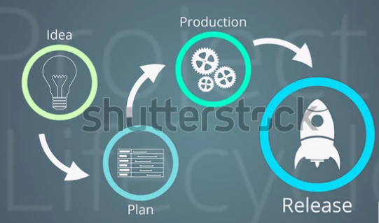

Software Development

Slide 5
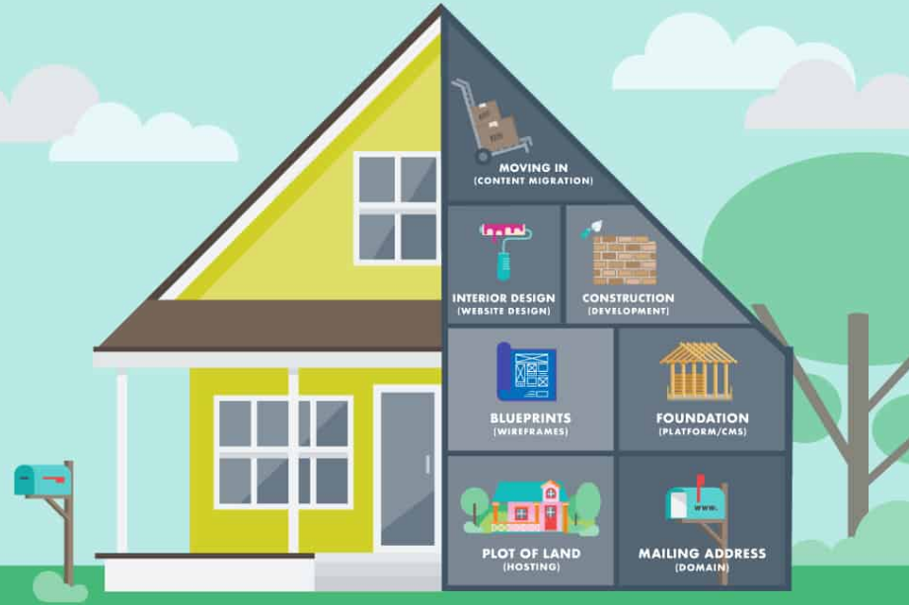
building a house

Slide 6



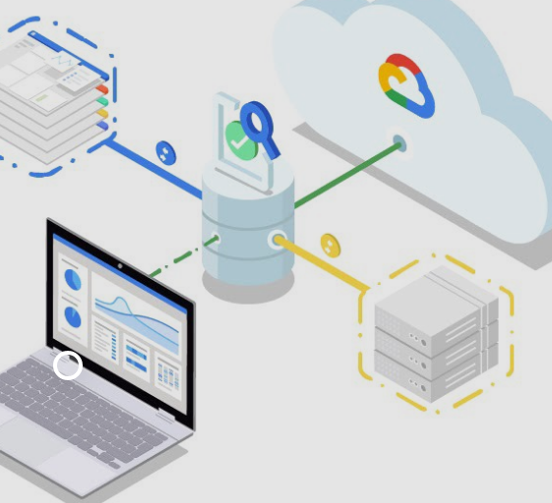


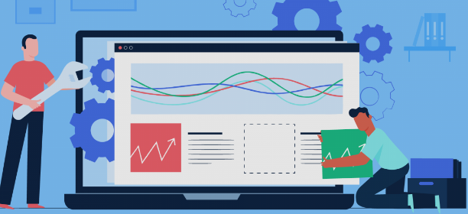

So, when you're building a software, similar to building a house

Slide 7







System Development Life Cycle
organizational
 System Development Life Cycle is an process of
developing and maintaining systems.
System development life cycle means combination of various activities .
Following are the different ^{phases} of software development cycle:
System study
Feasibility study
System analysis
System design
Coding
Testing
Implementation
Maintenance

Slide 8

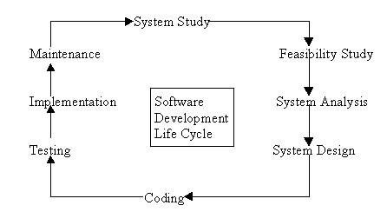
System Development Life Cycle

Slide 9

System Environments ?
Development
Test
Staging
Pre-Production
Production
Mirror
Roles involved:
 D, DM, PM, TM, CM & DT.

Slide 10

System Study
System study - 1st stage of system development life cycle.
Gives clear picture of what actually the physical system is.
System study phases (I & II):
I: initial survey of the system - helps in identifying the scope.
II: in-depth study - requirement identification / limitations & issues of current system.
Proposal:
Prepared after completing the system study,
prepared by the System Analyst.
Contains the findings of the current system
Recommendations to overcome the limitations / issues of the
current system.
Steps of System study phase:
problem identification and project initiation.
background analysis.
inference or findings.

Slide 11
Feasibility Study
Done on the basis of initial study.
It is the test of the proposed system in the light of its workability, user’s requirements, effective use of resources and the cost effectiveness.
Goal :The main aim of feasibility study is to how to achieve the scope. (not to solve issues)
Advantage: Cost and benefits are estimated with greater accuracy.

Slide 12
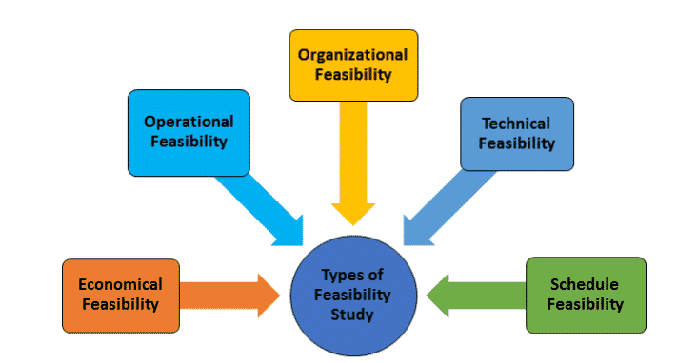
Feasibility Study

Slide 13
Feasibility Study
The various types of feasibility Checks are:
Economic Feasibility – Whether the project can be completed within the budget.
Operational Feasibility ­– Whether the problem can be solved with the existing and proposed system in the user’s environment.
Organizational/Legal Feasibility – Can the project be handled consistently with the company policies/objectives.
Technical Feasibility – Can the problem be solved with the present computer system and the resources available.
Schedule Feasibility – Whether the project can be completed within the given timeframe or not.

Slide 14

System Analysis
Analysis is detailed study of :
current system, leading to specifications of a new system.
system operations & its relationships within & outside system.
Data collection for: files, decision points, & transactions of present system.
Tools of system analysis: Interviews, on-site observation & questionnaire.
Steps to define boundary of the new system:
Keeping in view the problems and new requirements
Workout pros & cons including new system
Enlist what system not expected to do
Analysis is documented in: detailed DFDs, data dictionary, logical data structures & miniature specifications.
SRS is finalized
Includes sub-dividing of complex process, data store identification & manual processes.

Slide 15

System Analysis Action items
Specification of what the new system is to accomplish based on the user requirements.
Functional hierarchy showing the functions to be performed by the new system and their relationship with each other.
Function network which are similar to function hierarchy but they highlight the those functions which are common to more than one procedure.
List of attributes of the entities - these are the data items which need to be held about each entity (record)

Slide 16
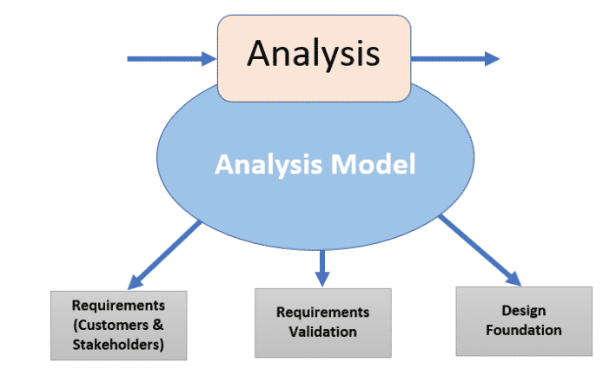
System Analysis

Slide 17

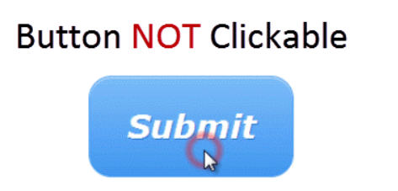
Verification vs Validation
A clickable button with name Submet

Slide 18




System Design
 Based on the and the detailed
user requirements
analysis
of a new system, the new system must
be designed.
 This is the phase of system designing. It is a
most crucial
phase in the development of a
system.
Normally, the design proceeds in two stages :
Preliminary or general design(High-Level Design)
Structure or Detailed design(Low- Level Design)

Slide 19
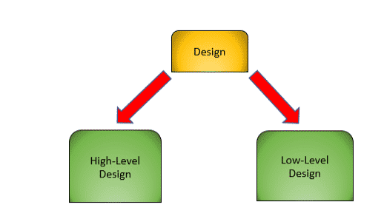
Input:SRS (Software Requirement Specification) is the reference document used in this phase for the product to be developed.
Results:detailed system document(by using several tools)
workable plan for implementation

Slide 20
High-level Design
High-level Design is the overall system design, covering the details at macro level.
list of modules and brief description of each module.
Brief functionality of each module.
Database tables identified with their key elements.
Complete architectural diagrams (data flow, flowcharts, and data structures) with technology details.

Slide 21
Low-Level Design
Low-Level Design is like detailing the HLD, a micro level design document.
Other key aspects in it include:
Detailed functional logic of module.
Database tables with their type and size.
All interface details.
Listing of error messages.
Complete input and outputs for a module.

Slide 22



Coding
Coding the new system into computer programming language
converts human instructions into a format that computer understands.
Coding is stage where defined procedure are transformed into control specifications by the help of a computer language.
This is also called the programming phase in which the programmer converts the program specifications into computer instructions, which we refer as programs.
The programs coordinate the ^{data movements}_ and control the entire process in a system.
modular

Slide 23

Testing
Removing all the bugs, if any - Before implementing
Test plan is developed and run on given set of test data.
Output of test run should match expected results.
Using test data following test runs are carried out:
Unit test: After coding / compiling programs, they are individually tested with test data. Any ambiguity must be noted & debugged.
System Test: done after unit test. Complete system is executed on actual data. Results or output of system is analyzed. If output is not matched with expected outputs, errors are identified and are fixed.

Slide 24
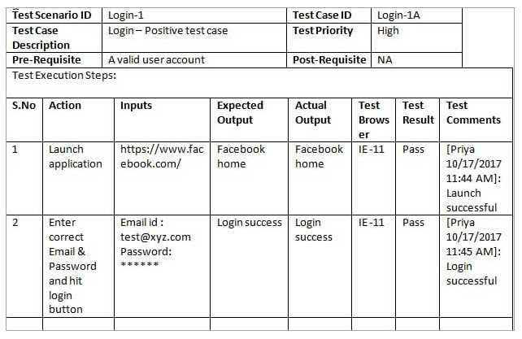
Test case example

Slide 25

Implementation
After UAT, the implementation phase begins.
It is the stage during which theory is turned into
practice.
All programs of the system are loaded onto the user's computer.
After loading the system, training of the users starts.
Main topics of such type of training are:
How to execute the package
How to enter the data
How to process the data (processing details)
How to take out the reports
After the users are trained about the computerized system, manual working has to shift from manual to computerized working.

Slide 26
System Run Strategies:
Parallel Approach
When the new system is used at the same time as the old system the two systems are said to be running in parallel.
Advantages:
Users can can compare the output of the old system with the output of the new system, to ensure correctness
There is little risk of data loss because the known-good system is running
Disadvantages:
Users must take more time to enter data into two different systems
Data could be different in two different systems if there is intensive data entry.

Slide 27
System Run Strategies:
Phased Approach
When small parts of the new system gradually replace small parts of the old system, the implementation method is said to be phased.
Advantages:
Training can be completed in small parts
A failure of the new system has minimal impact because it is only one small part
Issues around scale can be addressed without major impact.
Disadvantages:
This implementation method takes more time to get the new system fully online than other methods.
There is a possibility of data loss if part of the new system fails.

Slide 28
System Run Strategies:
Pilot Approach
When a small group of users within an organization uses a new system prior to wider use, the system is said to be piloted.
Advantages:
Training can be supported by pilot group
Failure or problems can be identified and addressed without wide-spread impact to the organization
Disadvantages:
In a pilot, issues of scale can cause problems. For example, the system might work well for 10 users, but not for 1000.

Slide 29
System Run Strategies:
Direct Approach
When a new system is implemented without any phased or pilot implementation, it is said to be direct. The old system is retired, and the new system goes live.
Advantages:
If the system is not critical, this can be a good method for implementation
Disadvantages:
If you are not sure the system will work, this method of implementation may not be a good idea

Slide 30

Maintenance
Maintenance is required to:
eliminate errors in the system during its working life
tune the system to any variations in its working
environment.
Errors are always in system that must be corrected.
System Review: is necessary from time to time for:
knowing the full capabilities of the system
knowing the required changes or the additional requirements
studying the performance
Major change during the review:
If a major change to a system is needed, a new project may have to be set up to carry out the change.
New project will then proceed through all above life cycle phases.

Slide 31
Types of changes
Corrective : Correctness of new bugs found
Adaptive : system adjustments to environmental changes (upgrade)
Adjustments for the user’s changing needs
Preventative Maintenance
Preventive maintenance is the modification of software to detect and correct software errors before they take effect.
Perfective : changes to use better techniques when they become available

Slide 32
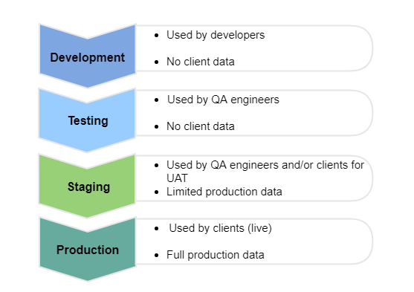
Environments in Software Development (DTAP)

Slide 33
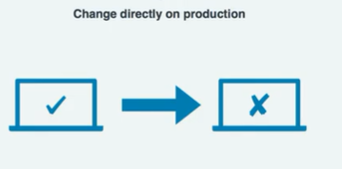
Scenario 1

Slide 34
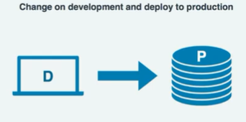
Scenario 2

Slide 35
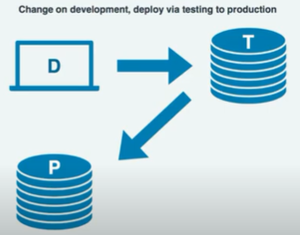
Scenario 3

Slide 36
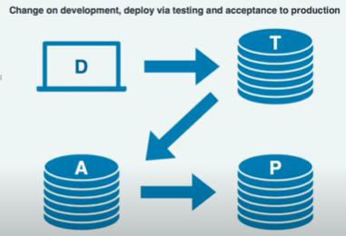
Scenario 4

Slide 37
Software Development Project Roles
“ Get the right people. Then no matter what all else you might do wrong after that, the people will save you. That’s what management is all about. ” – Tom DeMarco
PROJECT SPONSOR “Unengaged sponsor sinks the ship”
SUBJECT MATTER EXPERTS (SME)
PRODUCT OWNER
PROJECT MANAGER (PM)
Business Analyst
TECHNICAL LEAD
SOFTWARE DEVELOPERS
SOFTWARE TESTERS

Slide 38
OOP basic concept

Slide 39

Basic OOP Concepts and Terms
Let’s begin with an object and class,
But before starting……
Can anybody differentiate between OOP and Procedural Programming?

Slide 40
Class And Objects:
Activity:
Annotate Around the
Circle.
Class

Slide 41
Class And Objects:
Activity:
Annotate Around the
Circle.
Object

Slide 42
Class And Object:
Object is an entity having their own attributes and operations.
Class is a blueprint, a design and we can say a mold through which different objects are created.

Slide 43
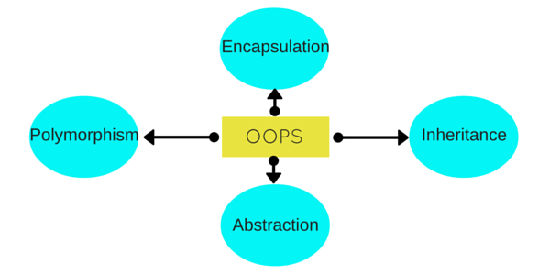
OPPs Pillars:
Activity:
Annotate around the Ellipse.

Slide 44
Inheritance:
Can we generalize classes?
Generalization happens to be one of the main design principles of object-oriented modeling and programming.
how is this done?
Generalization can be achieved by classes through inheritance.
In generalization we take repeated, common, or shared characteristics between two or more classes and factor them out into another class.
Specifically, you can have two classes, a parent class and a child class.

Slide 45
Inheritance:
Let's say you want to model a cat .
Cat has four legs, a tail, knows how to walk, run and eat
General class?
An animal, then, is a general idea.
Inheritance and methods exemplify the generalization design principle.
Generalization will help you build software that is easier to expand,
easier to apply changes to and easier to maintain

Slide 46
Inheritance:
Property of an object to acquire all the properties and behavior of its parent object.
Inheritance represents the “is-a” relationship.

Slide 47
Polymorphism:
Many forms
Compile time polymorphism or static polymorphism.(overloading)
Run time polymorphism or dynamic polymorphism.(overriding)

Slide 48
Abstraction:
Abstraction is the idea of simplifying a concept in the problem domain to its essentials within some context
Good abstraction emphasizes the essentials needed for the concept and removes details that are not essential.
An abstraction that hides the internal implementation details. (coffee machine example)
Abstraction means displaying only essential information and hiding the details.

Slide 49
Abstraction:
Let's take the concept of a person.
What are the essential characteristics of a person that we care about?
Well, it's hard to say because person is so vague and we haven't said what the purpose of our person is.
The abstractions you create are relative to some context
Let's look at an example where our context is an academic setting, and we want to create an abstraction for a student.
What are some of the essential characteristics of a student?

Slide 50
Encapsulation:
In normal terms Encapsulation is defined as wrapping up of data and information under a single unit.
In Object Oriented Programming, Encapsulation is defined as binding together the data and the functions that manipulates them

Slide 51
Encapsulation:
Encapsulation involves three ideas.
As the name suggests, it's about making a sort of capsule.
The capsule contains something inside,
some of which you can access from the outside,
and some of which you cannot.
First, you bundle attribute values or data, and behaviors or functions, that manipulate those values together into a self-contained object.
Second, you can expose certain data and functions of that object, which can be accessed from other objects.
Third, you can restrict access to certain data and functions to only within that object.

Slide 52

Activity:
example of an Uber app! a real world scenario explaining OOP (Class, Object, Abstraction , polymorphism, encapsulation , inheritance)

Slide 53
Difference between SAD and OOAD
Tools used in SAD

Slide 54
Difference Between Structured and Object-oriented analysis :
Structured Analysis | Object-Oriented Analysis
The main focus is on process and procedures of system. | The main focus in on data structure and real-world objects that are important.
It uses System Development Life Cycle (SDLC) methodology for different purposes like planning, analyzing, designing, implementing, and supporting an information system. | It uses Incremental or Iterative methodology to refine and extend our design.
It is suitable for well-defined projects with stable user requirements. | It is suitable for large projects with changing user requirements.
Risk while using this analysis technique is high and reusability is also low. | Risk while using this analysis technique is low and reusability is also high.
Structuring requirements include DFDs (Data Flow Diagram), Structured English, ER (Entity Relationship) diagram, CFD (Control Flow Diagram), Data Dictionary, Decision table/tree, State transition diagram. | Requirement engineering includes Use case model (find Use cases, Flow of events, Activity Diagram), the Object model (find Classes and class relations, Object interaction, Object to ER mapping), Statechart Diagram, and deployment diagram.
This technique is old and is not preferred usually. | This technique is new and is mostly preferred.

Slide 55
Structured Analysis and Design(Traditional approach)
SA/SD is combined known as SAD
SA/SD involves 2 phases:
Analysis Phase: It uses Data Flow Diagram, Data Dictionary, State Transition diagram and ER diagram.
Design Phase: It uses Structure Chart and Pseudo Code.

Slide 56
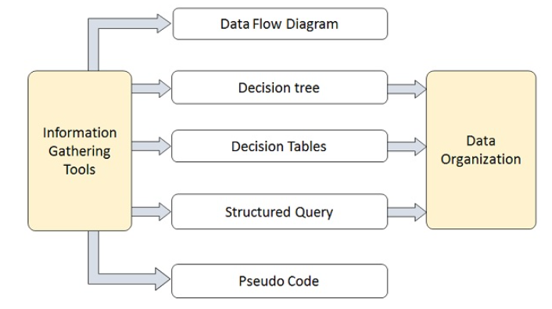
Structured Analysis Tools

Slide 57
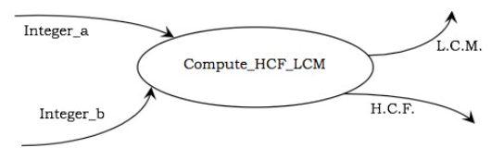
Data Flow Diagrams (DFD)

Slide 58
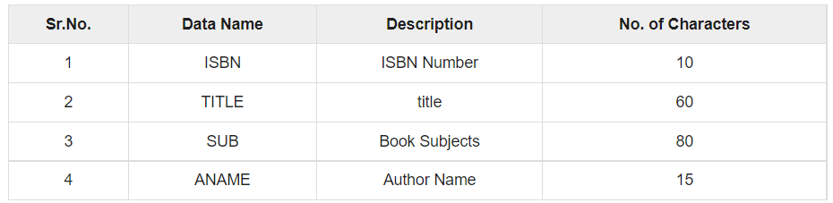
Data Dictionary

Slide 59
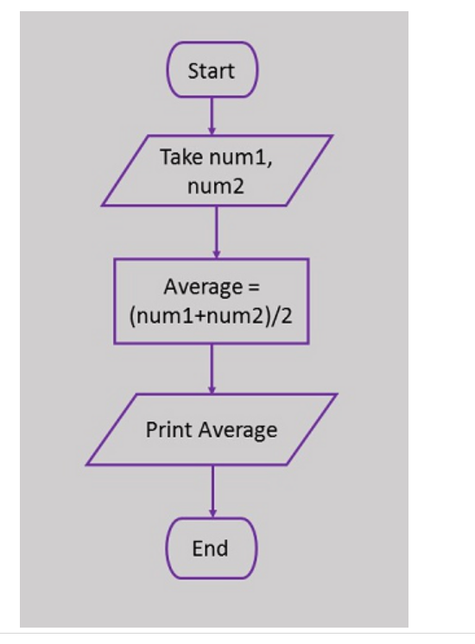
Flowchart
Flowchart is a diagrammatic representation of sequence of logical steps of a program.

Slide 60
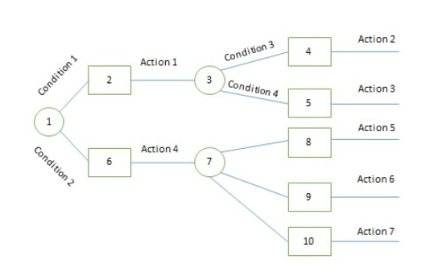
Decision Trees

Slide 61
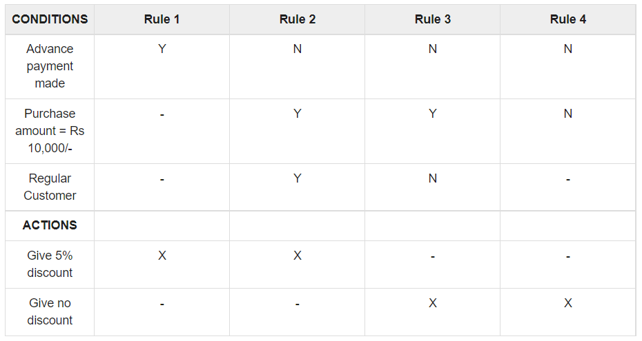
Decision Tables

Slide 62
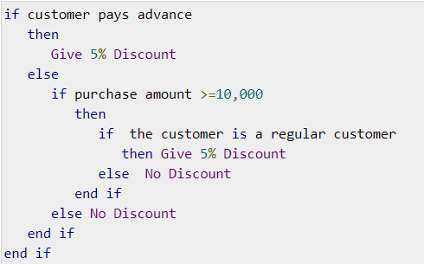
Structured English

Slide 63
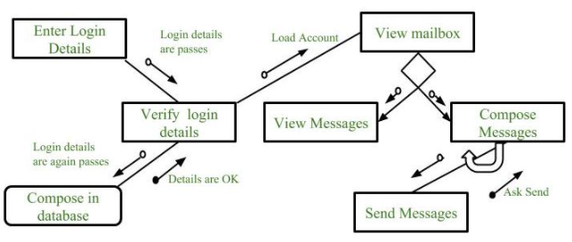
Structure Chart

Slide 64
Pseudocode
Examples:
1.. If student's grade is greater than or equal to 60
Print "passed"
else
Print "failed"

